Slide 1
E-commerce: Digital Markets, Digital Goods
Chapter 5

Slide 2
Unique Features of E-commerce, Digital Markets, and Digital Goods
E-commerce: Use of the Internet and Web to transact business.
Began in 1995 and grew exponentially; still stable even in a recession.
Companies that survived the dot-com bubble now thrive.
The new e-commerce: social, mobile, local
Notes:
This slide discusses what e-commerce is, and what the state of e-commerce is today. The text states that e-commerce history mirrors those of other technology innovations. What other innovations is e-commerce similar to? Students probably will not know about the early days of radio and TV, but perhaps they will remember cassette music, VHS video tapes, and even CDs and DVDs which, though still with us, are definitely declining in sales. The book discusses new trends in e-commerce. Ask the students to work with you to list some of these new trends in e-commerce.

Slide 3
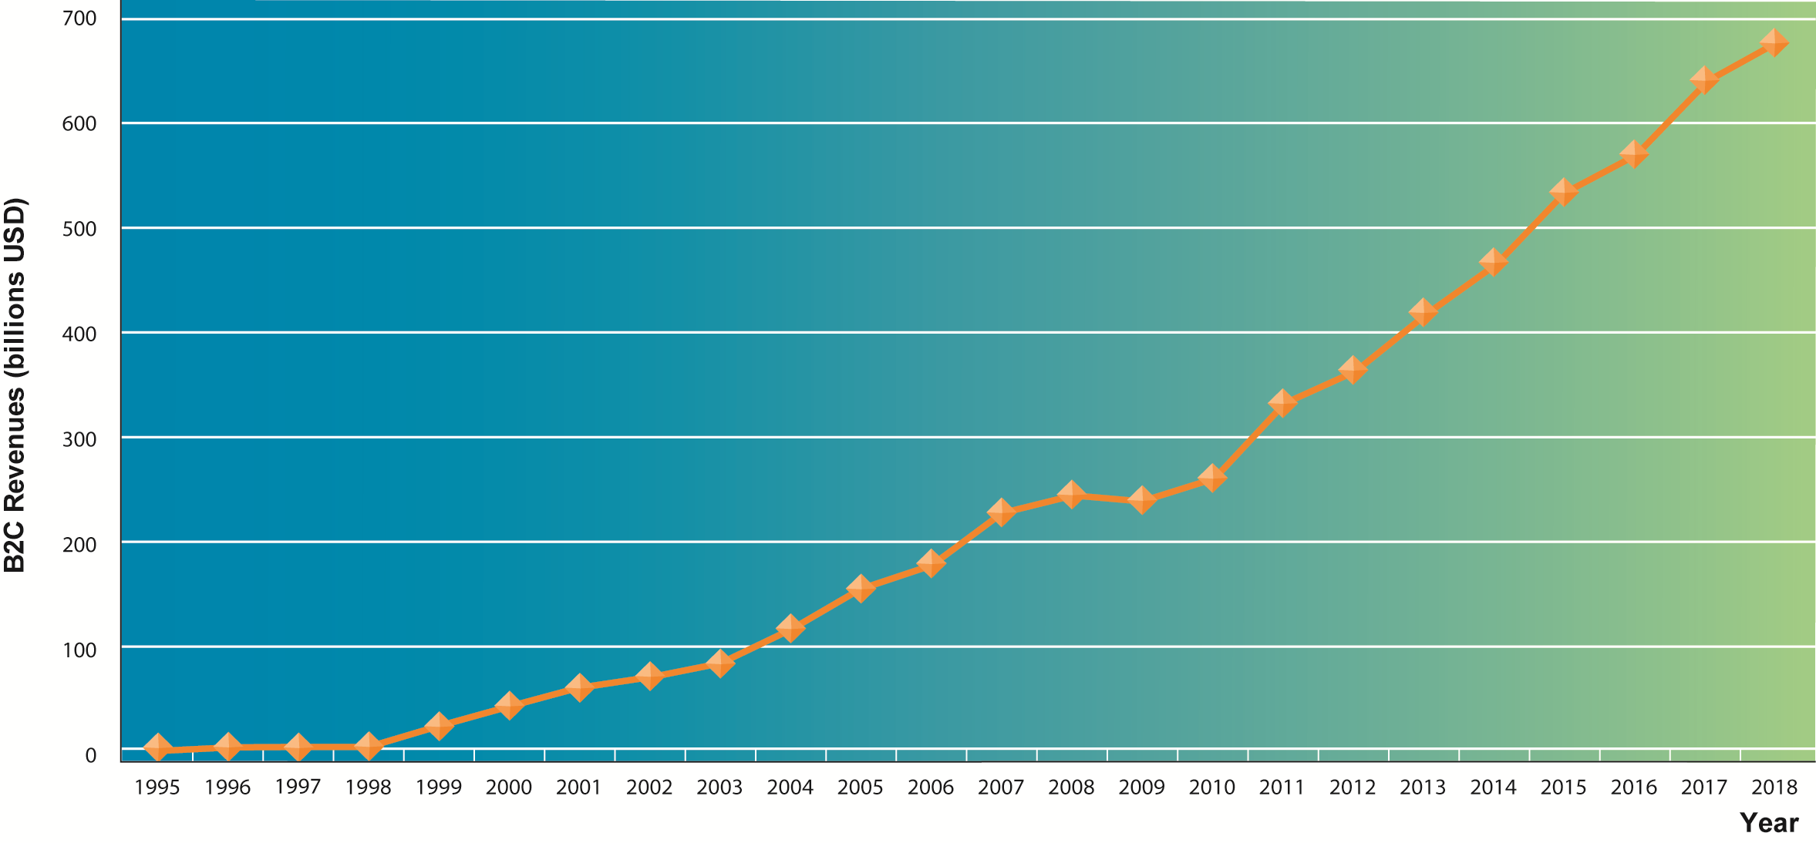
The Growth of E-commerce
Figure 10-1
Retail e-commerce revenues grew 15–25 percent per year until the recession of 2008–2009, when they slowed measurably. In 2014, e-commerce revenues are growing again at an estimated 12 percent annually.
Notes:
This graphic illustrates the continuing growth of e-commerce. The growth of e-commerce revenues grew 15 percent to 25 percent a year until the recession of 2008–2009, when they slowed measurably to a small positive number around 3 percent in 2009. This was much better than traditional retail commerce which actually shrank in this recession. E-commerce began growing again after 2009 at more than 10 percent, several times the growth of all retail sales.

Slide 4
Unique Features of E-commerce, Digital Markets, and Digital Goods
Eight unique features of Internet and Web as commercial medium
  Ubiquity
  Global reach
  Universal standards
  Richness
  Interactivity
  Information density
  Personalization/customization
  Social technology
Notes:
This slide introduces the unique features of the Internet. These features explain why e-commerce has grown so quickly—because of the unique nature of the Internet and e-commerce, which are richer and more powerful than previous technology revolutions such as radio and TV.

Slide 5
Unique Features of E-commerce, Digital Markets, and Digital Goods
Effect of the Internet on the marketplace:
  Reduces information asymmetry
  Offers greater flexibility and efficiency because of:
    Reduced search costs and transaction costs
    Lower menu costs
    Greater price discrimination
    Dynamic pricing
  May reduce or increase switching costs
  May delay gratification: effects dependent on product
  Increased market segmentation
  Stronger network effects
  More disintermediation
Notes:
This slide introduces digital markets and discusses the effects of digital markets on the ways companies conduct business. Ask students to define the terms listed here, and also to explain how each of these effects (lowered information asymmetry, etc.) are created by digital markets. Go through each of the three types of costs involved in any marketplace. Students may not be familiar with these words, but they will be familiar with the phenomenon. For instance, all students will recognize that it takes time and money to go to a mall to find a shirt (this is search cost). The same shirt can be bought on the Web today with minimal search costs.
Information asymmetry: when one party in a transaction has more information that is important for the transaction than the other party.
Search costs: the effort to find suitable products.
Transaction costs: the cost of participating in a market.
Menu costs: merchants’ costs of changing prices.
Price discrimination: selling the same goods, or nearly the same goods, to different targeted groups at different prices.
Dynamic pricing: the price of a product varies depending on the demand characteristics of the customer or the supply situation of the seller.
Disintermediation: the removal of organizations or business process layers responsible for intermediary steps in a value chain.

Slide 6
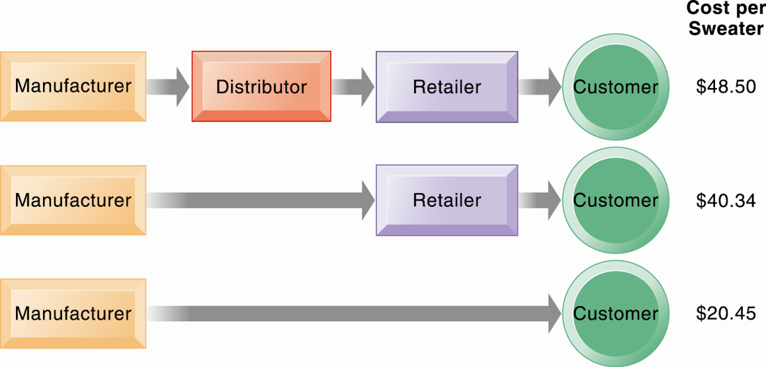
The Benefits of Disintermediation to the Consumer
Figure 10-2
The typical distribution channel has several intermediary layers, each of which adds to the final cost of a product, such as a sweater. Removing layers lowers the final cost to the consumer.
Notes:
This graphic illustrates how disintermediation reduces prices to consumers. It also allows manufacturers to earn more profit for the product by eliminating the middle man. Are middle men really necessary? You should ask students who they think is a “middle man.” Walmart is, for instance, a distributor and retailer. Do they provide an important function? Why can’t manufacturers just ignore Walmart and sell directly to the customer? Even though market disintermediation sounds like a good thing because costs and prices go down, for the most part manufacturers kept their distribution partners and channels. Walmart is still needed by manufacturers such as P&G to sell soap.

Slide 7
Unique Features of E-commerce, Digital Markets, and Digital Goods
Digital goods
  Goods that can be delivered over a digital network
    For example: music tracks, video, software, newspapers, books
  Cost of producing first unit is almost entire cost of product
  Costs of delivery over the Internet very low
  Marketing costs remain the same; pricing highly variable
  Industries with digital goods are undergoing revolutionary changes (publishers, record labels, etc.)
Notes:
This slide continues the discussion of key concepts in e-commerce, looking at digital goods and how these compare with traditional goods.
Ask students how their purchases of digital goods have changed over the past five years. Are digital goods equal in value to their traditional counterparts? What benefits and drawbacks do they have? Music for instance used to be a physical product (record or CD) not a digital product or digital service.

Slide 8
E-commerce Business and Revenue Models
Three major types of e-commerce
  Business-to-consumer (B2C)
    Example: BarnesandNoble.com
  Business-to-business (B2B)
    Example: ChemConnect
  Consumer-to-consumer (C2C)
    Example: eBay
E-commerce can be categorized by platform
  Mobile commerce (m-commerce)
Notes:
This slide introduces the types of e-commerce. B2C, B2B, and C2C e-commerce are categorized according to the nature of the participants. M-commerce is a category based on the nature of the connection to the Internet. Ask students to provide examples of the different types of e-commerce listed here. Most students will find it hard to come up with a B2B example. One place you can visit on the Web is grainger.com, one of the largest B2B marketplaces in the United States. Another is mcmaster.com, and also elemica.com (chemical industry).

Slide 9
E-commerce Business and Revenue Models
E-commerce business models
  Portal
  E-tailer
  Content provider
  Transaction broker
  Market creator
  Service provider
  Community provider
Notes:
This slide continues the discussion of new Internet business models. Ask students to give examples of these business models. For each model, ask students about their experience, or ask for examples for each model. Ask how these business models create revenue. For instance:
Content provider revenue: access fees, advertising
Portal revenue: advertising
Service provider revenue: subscription fees, advertising
Community provider (could be Facebook) revenue: sales of virtual goods, display ads

Slide 10
E-commerce Business and Revenue Models
E-commerce revenue models
  Advertising
  Sales
  Subscription
  Free/Freemium
  Transaction fee
  Affiliate
Notes:
This slide and the next several slides discuss new business models that are enabled by the Internet and e-commerce. Although many of the new business models are pure-play, some, especially in the retail industry, are clicks-and-mortar.
Some of the new models take advantage of the Internet’s communication capabilities, such as the social networking sites. Ask students what other sites take advantage of the Internet’s communication abilities.
Ask students to differentiate between banner ads and popup ads.

Slide 11
Can Pandora Succeed with Freemium?
Analyze Pandora using the value chain and competitive forces models. What competitive forces does the company have to deal with? What is its customer value proposition?
Explain how Pandora’s “freemium” business model works. How does the company generate revenue?
Can Pandora succeed with its “freemium” model? Why or why not? What people, organization, and technology factors affect its success with this business model?

Slide 12
How Has E-commerce Transformed Marketing?
E-commerce marketing
  Internet provides new ways to identify and communicate with customers.
  Long tail marketing:
    Ability to reach a large audience inexpensively
  Internet advertising formats
  Behavioral targeting:
    Tracking online behavior of individuals on thousands of Web sites and within apps
    Privacy concerns
Notes:
Ask students to explain why marketers are looking to analyze blog content, and content from chat rooms and message boards. Have students describe and evaluate their experiences with advertising on social networks, via e-mail and other online formats.

Slide 13
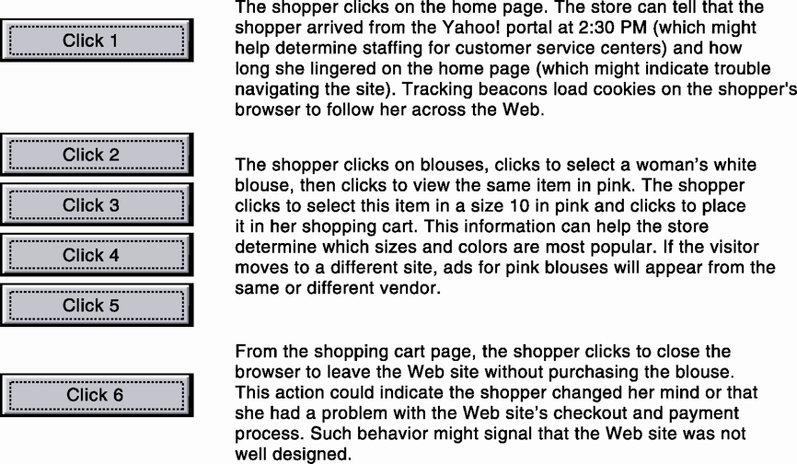
Web Site Visitor Tracking
E-commerce Web sites have tools to track a shopper's every step through an online store. Close examination of customer behavior at a Web site selling women's clothing shows what the store might learn at each step and what actions it could take to increase sales.
Figure 10-3
Notes:
This graphic illustrates how clickstream tracking works and what the store can tell about the activities of a shopper on their Web site. Extensive metrics exist for various types of user behavior, from the time spent on a Web page to the number of products ordered and placed in a shopping cart but not purchased.

Slide 14
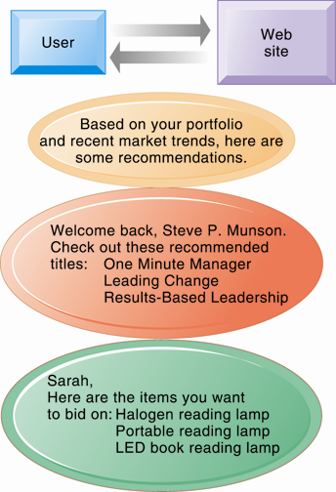
Web Site Personalization
Firms can create unique personalized Web pages that display content or ads for products or services of special interest to individual users, improving the customer experience and creating additional value.
Figure 10-4
Notes:
This graphic illustrates some of the types of personalization that clickstream tracking can make possible. Have students found suggestions made by a Web site useful in their experience? You can go to Amazon.com and illustrate how recommender systems work. Search for a product, and then scroll to the bottom of the page where Amazon’s recommender will tell you what other people who looked at the current page actually bought. Netflix is also an excellent site to demonstrate personalization.

Slide 15
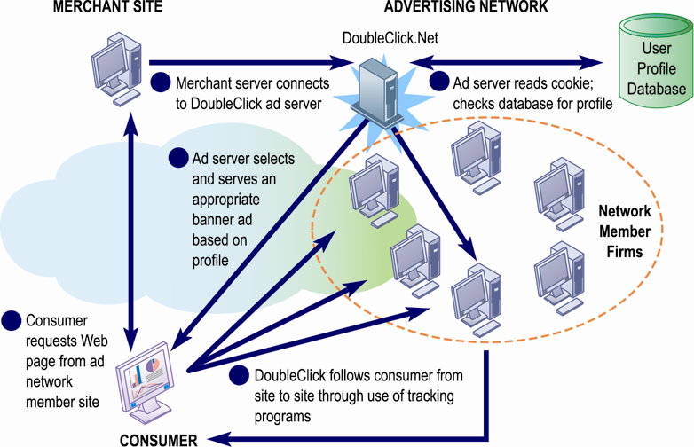
How an Advertising Network Works
Advertising networks and their use of tracking programs have become controversial among privacy advocates because of their ability to track individual consumers across the Internet.
Figure 10-5
Notes:
What do students think (or do they think) about how advertising networks follow them around the Internet? It’s actually quite difficult for anyone to know when they are being tracked by a network, and even more difficult to find out how the information is being used?

Slide 16
E-commerce Business and Revenue Models
Social e-commerce:
  Based on digital social graph
Features of social e-commerce driving its growth
  Newsfeed
  Timelines
  Social sign-on
  Collaborative shopping
  Network notification
  Social search (recommendations)
Notes:
Ask your class who has a Facebook page. A forest of hands will rise. How many have purchase something while on their Facebook page, or clicks routinely on ads? Generally, people do not go to Facebook to buy things and are not clicking on display ads (less than 2 percent of users).

Slide 17
E-commerce Business and Revenue Models
Social media:
  Fastest growing media for branding and marketing
Social network marketing:
  Seeks to leverage individuals influence over others in social graph
  The target is a social network of people sharing interests and advice
  Facebook’s “Like button”
  Social networks have huge audiences
    Facebook: 137 million U.S. visitors monthly
Notes:
Facebook and Google’s +1 social network are rapidly growing. Facebook reached 800 million worldwide, with 200 million in the United States. In the space of its first six months, LinkedIn has 40 million monthly visitors.

Slide 18
How Has E-commerce Transformed Marketing?
Social shopping sites
Wisdom of crowds
Crowdsourcing
  Large numbers of people can make better decisions about topics and products than a single person.
Prediction markets
  Peer-to-peer betting markets on specific outcomes (elections, sales figures, designs for new products)
Notes:
Most students will be well aware of social networking technologies, but have they heard of prediction markets? Ask them to investigate this further on their own time. How can these techniques and phenomenon be used by business firms? LinkedIn is the largest professional and business social network that members often use to recruit employees and find jobs.

Slide 19
E-commerce and Business-to-Business Transactions
B2B e-commerce
  U.S. B2B trade in 2014 is $13.8 trillion
  U.S. B2B e-commerce in 2014 is $5.7 trillion
  Procurement requires significant overhead costs, which Internet and networking helps automate
  Variety of Internet-enabled technologies used in B2B
    Electronic data interchange (EDI)
    Private industrial networks (private exchanges)
    Net marketplaces
    Exchanges
Notes:
This slide looks at changes brought to B2B e-commerce by Internet technologies. Note that the Internet and Web technology enable businesses to create new electronic storefronts for selling to other businesses with multimedia graphic displays and interactive features similar to those for B2C commerce. Alternatively, businesses can use Internet technology to create extranets or electronic marketplaces for linking to other businesses for purchase and sale transactions.

Slide 20
M-commerce and M-commerce Applications
M-commerce
  In 2014 is 19 percent of all e-commerce
  Fastest growing form of e-commerce
    Some areas growing at 50 percent or more
  Main areas of growth (exclusive of location-based services)
    Retail sales at top Mobile 400 (Amazon, eBay, etc.)
    Sales of digital content (music, TV, etc.)
Notes:
This slide introduces m-commerce, the use of wireless mobile devices for purchasing goods and services. Ask students what applications and services they use with their cell phones. Have any purchased games or entertainment, and from what companies? Have any used OpenTable on a smartphone?

Slide 21
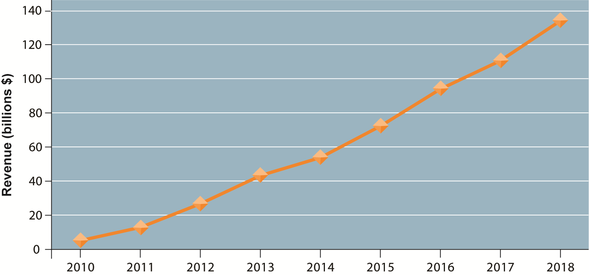
Consolidated Mobile Commerce Revenues
Figure 10-9
Mobile e-commerce is the fastest growing type of B2C e-commerce and represents about 19 percent of all e-commerce in 2014.
Notes:
This graph illustrates the surging growth of m-commerce sales from today to 2018. In the early years prior to 2009, m-commerce in the United States was very small and not growing rapidly. Cell phones, especially smartphones, have changed that. Have any of the students purchased something using their cell phone or mobile laptop computer? How many students are using a smartphone? How many have used a smartphone app to compare prices while shopping at stores?

Slide 22
M-commerce and M-commerce Applications
Location-based services
  Used by 74 percent of smartphone owners
  Based on GPS map services
  Types
    Geosocial services
      Where friends are
    Geoadvertising
      What shops are nearby
    Geoinformation services
      Price of house you are passing
Notes:
M-commerce is especially well-suited for location-based applications and services. Have any students used a location-based service? A neat site to visit is http://www.wikitude.org/ and explore Wikitude.me, a geo-tagging service.

Slide 23
Will Mobile Technology Put Orbitz in the Lead?
How important is mobile technology in Orbitz’s business strategy? Why?
What management, organization, and technology issues did Orbitz need to address in its mobile strategy?
Why are mobile phone users much more likely to book same-day hotel room or airline reservations?
What role does Orbitz for Business play in the company’s business strategy?
How successful is Orbitz’s mobile strategy? Explain your answer.

Slide 24
M-commerce and M-commerce Applications
Other mobile commerce services
  Banks, credit card companies provide account management apps
  Mobile display advertising
    iAd, AdMob, Millenial Media, Facebook
    Ads embedded in games, videos, and mobile apps
  55 percent of online retailers have m-commerce Web sites

Slide 25
Building an E-commerce Presence
Most important management challenges
  Developing clear understanding of business objectives
  Knowing how to choose the right technology to achieve those objectives
Develop an e-commerce presence map
  Four areas: Web sites, e-mail, social media, offline media
Develop a timeline: milestones
  Breaking a project into discrete phases
Notes:
Building a Web site involves a number of considerations. If its an e-commerce site, customer preferences should be the driving force behind the design. What are customers looking for, how can they find it on your site, and how easily can they purchase on your site? How will you choose the technology? What about your sites information policy? What’s that? If you don’t know, your customers will surely expect you to know.

Slide 26
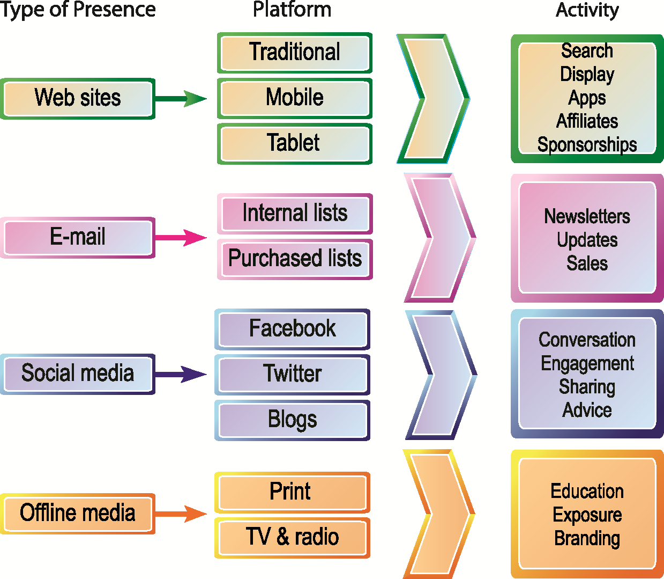
Building an E-commerce Presence
E-commerce Presence Map
An e-commerce presence requires firms to consider the four different types of presence, with specific platforms and activities associated with each.
Figure 10-10

Slide 27
Building an E-commerce Presence
E-commerce Presence Timeline
Phase | Activity | Milestone
Phase 1: Planning | Envision Web presence; determine personnel | Web mission statement
Phase 2: Web site development | Acquire content; develop a site design; arrange for hosting the site | Web site plan
Phase 3: Web Implementation | Develop keywords and metatags; focus on search engine optimization; identify potential sponsors | A functional Web site
Phase 4: Social media plan | Identify appropriate social platforms and content for your products and services | A social media plan
Phase 5: Social media implementation | Develop Facebook, Twitter, and Pinterest presence | Functioning social media presence
Phase 6: Mobile plan | Develop a mobile plan; consider options for porting your Web site to smartphones | A mobile media plan
Table 10-8

